Slide 1
Mini Presentation 5
27 August 2020

Slide 2
Logistic Regression
Background
Marketing campaigns are costly to conduct, thus, it is imperative to maximise the return of the marketing campaigns . Hence, there is a need to ascertain how likely the marketing campaign is able to meet its objective, i.e. to get the desired number of customers to open a term deposit account, before launching the campaign.
Problem Statement
What is the chance that the customers will open a term deposit account with the new marketing campaign ?
Approach
The binary classification goal is to predict if the client will subscribe a bank term deposit (variable y). To build a logistic regression with the most appropriate factors to predict the customer outcome.

Slide 3
Dataset - Bank Marketing Campaigns Results
bank-additional-full.csv.csv
It is a dataset that describes a Portugal bank’s marketing campaigns results. The campaigns were conducted based mostly on direct phone calls, offering bank client to place a term deposit. The target variable – “y” is marked ‘yes’ if the client agreed to place a term deposit, otherwise marked ‘no’.
Number of Instances: 41,188
Number of Attributes: 20 + output attribute. Details of attributes available in the appendix
Source of the data https://www.kaggle.com/volodymyrgavrysh/bank-marketing-campaigns-dataset
Original source : https://archive.ics.uci.edu/ml/datasets/bank+marketing

Slide 4
Dataset - Attributes
Bank client data
# | Attribute | Data Types | Details
1. | age | Numeric | Age of customer
2. | job | Object | Type of job (categorical: "admin.","blue-collar","entrepreneur","housemaid","management","retired","self-employed","services","student","technician","unemployed","unknown“)
3 | marital | Object | marital status (categorical: "divorced","married","single","unknown"; note: "divorced" means divorced or widowed)
4 | education | Object | (categorical: "basic.4y","basic.6y","basic.9y","high.school","illiterate","professional.course","university.degree","unknown")
5 | default | Object | has credit in default? (categorical: "no","yes","unknown")
6 | housing | Object | has housing loan? (categorical: "no","yes","unknown")
7 | loan | Object | has personal loan? (categorical: "no","yes","unknown")

Slide 5
Dataset - Attributes
Related with the last contact of the current campaign
# | Attribute | Data Types | Details
8 | contact | Object | contact communication type (categorical: "cellular","telephone")
9 | month | Object | last contact month of year (categorical: "jan", "feb", "mar", …, "nov", "dec")
10 | dayofweek | Object | last contact day of the week (categorical: "mon","tue","wed","thu","fri")
11 | duration | Integer | last contact duration, in seconds (numeric). Important note: this attribute highly affects the output target (e.g., if duration=0 then y="no"). Yet, the duration is not known before a call is performed. Also, after the end of the call y is obviously known. Thus, this input should only be included for benchmark purposes and should be discarded if the intention is to have a realistic predictive model.
Other attributes
# | Attribute | Data Types | Details
12 | campaign | Integer | number of contacts performed during this campaign and for this client (numeric, includes last contact)
13 | pdays | Integer | number of days that passed by after the client was last contacted from a previous campaign (numeric; 999 means client was not previously contacted)
14 | previous | Integer | number of contacts performed before this campaign and for this client (numeric)

Slide 6
Dataset - Attributes
Other attributes (cont)
# | Attribute | Data Types | Details
15 | poutcome | Object | outcome of the previous marketing campaign (categorical: "failure","nonexistent","success")
Social and economic context attributes
# | Attribute | Data Types | Details
16 | emp.var.rate | Float | employment variation rate - quarterly indicator (numeric)
17 | cons.price.idx | Float | consumer price index - monthly indicator (numeric)
18 | cons.conf.idx | Float | consumer confidence index - monthly indicator (numeric)
19 | euribor3m | Float | euribor 3 month rate - daily indicator (numeric)
20 | nr.employed | Float | number of employees - quarterly indicator (numeric)
Output variable (desired target)
# | Attribute | Data Types | Details
15 | y | Object | has the client subscribed a term deposit? (binary: "yes","no")

Slide 7
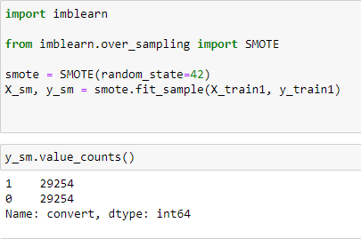
Exploratory Data Analysis
Cleaning data
Renamed column names
Checked for null values and missing values. The missing values are left as “unknown” as there is insufficient information to replace with appropriate values.
Target variable, y
Converted to binary with ‘yes’ = 1 and ‘no’ = 0
Imbalanced dataset
No. of observations with y attribute = ‘yes’ = 4,640
No. of observations with y attribute = ‘no’ = 36,548
Used Imblearn, SMOTE to rebalance the dataset

Slide 8
Exploratory Data Analysis (cont.)
Explore data
Checked the correlation of objects to target y using Excel and found no material correlation ie no distinct category of clients such as job, marital status, education level, etc that correlated to target y
Correlation matrix of the variables

Slide 9
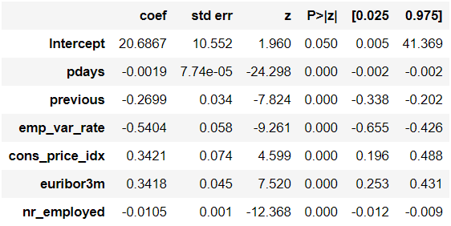
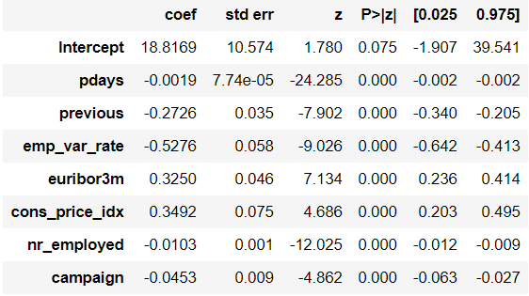
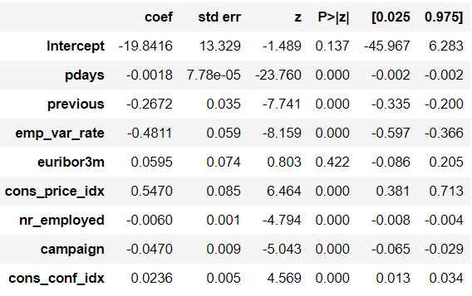
Model & Validate – Determine predictors
Determine Predictors / Feature Variables -Applied sm.logit to determine the predictors
1
2
3
Discarded as P for Euribor3m is not significant which is unlikely to be true

Slide 10


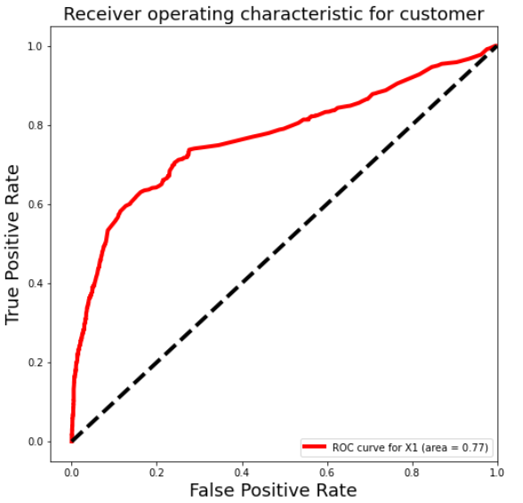
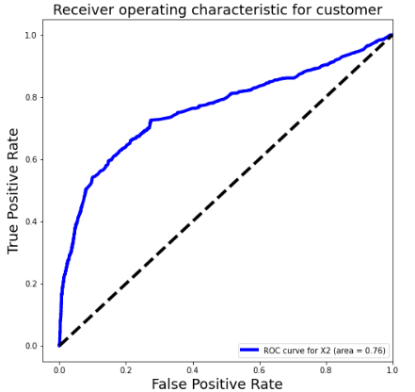
Model & Validate – Build with original data
Built Logistic Regression models fitted with predictors X1/X2
1
2
Score : 0.89991
Classification Accuracy : 0.89767
Classification Error : 0.10233
Sensitivity : 0.18326
Specificity : 0.99012
FPR : 0.00987
Precision : 0.70612
Score : 0.89979
Classification Accuracy : 0.89840
Classification Error : 0.10160
Sensitivity : 0.19174
Specificity : 0.98985
FPR : 0.01015
Precision : 0.70980

Slide 11


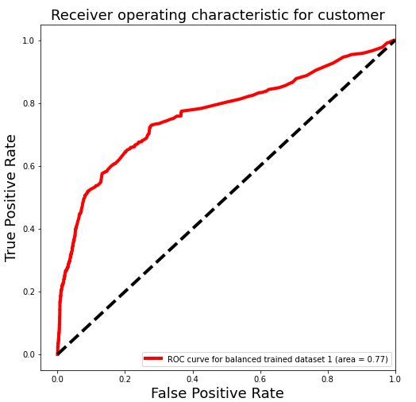
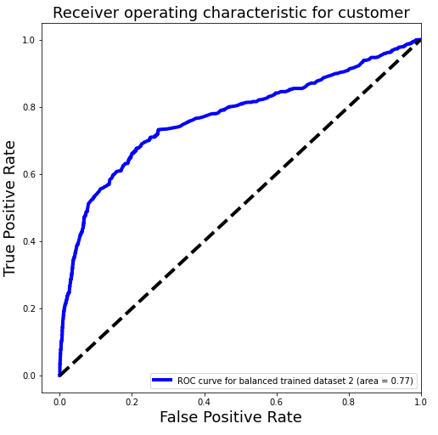
Model & Validate – Trained with balanced data
Built Logistic Regression models with predictors X1/X2 and trained with balanced data
1
2
Score : 0.71609
Classification Accuracy : 0.72518
Classification Error : 0.27482
Sensitivity : 0.72458
Specificity : 0.72525
FPR : 0.27475
Precision : 0.25446
Score : 0.73041
Classification Accuracy : 0.77179
Classification Error : 0.22821
Sensitivity : 0.67691
Specificity : 0.78407
FPR : 0.21593
Precision : 0.28862

Slide 12


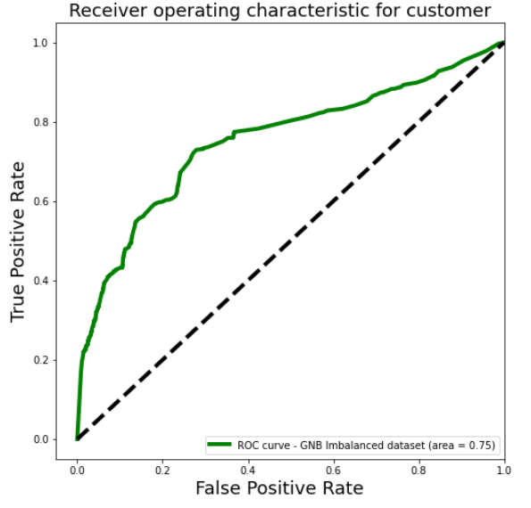
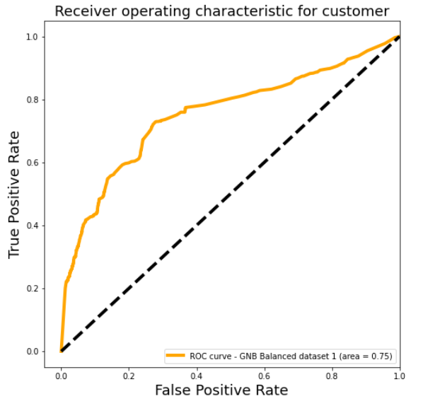
Model & Validate – GNB models
Built Naïve Bayes Regression models with predictors X1, trained with original and re-balanced data
3
3
Score : 0.82683
Classification Accuracy : 0.83078
Classification Error : 0.16922
Sensitivity : 0.50530
Specificity : 0.87291
FPR : 0.12709
Precision : 0.33974
Score : 0.71609
Classification Accuracy : 0.72518
Classification Error : 0.27482
Sensitivity : 0.72458
Specificity : 0.72525
FPR : 0.2747
Precision : 0.25446

Slide 13
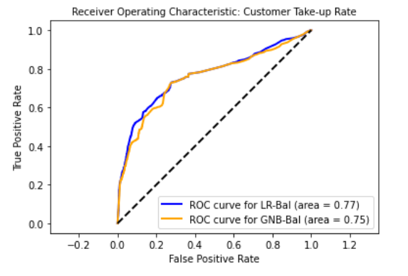
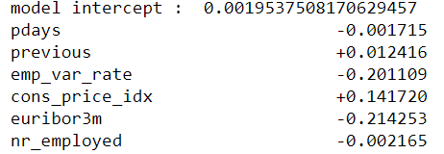
Model & Validate – LR vs GNB (balanced data)
Conclusion – LR model trained with balanced data set and predictor X1
1
* Preferred
Score : 0.71609
Classification Accuracy : 0.72518
Classification Error : 0.27482
Sensitivity : 0.72458
Specificity : 0.72525
FPR : 0.27475
Precision : 0.25446
3
Score : 0.71609
Classification Accuracy : 0.72518
Classification Error : 0.27482
Sensitivity : 0.72458
Specificity : 0.72525
FPR : 0.2747
Precision : 0.25446

Slide 14
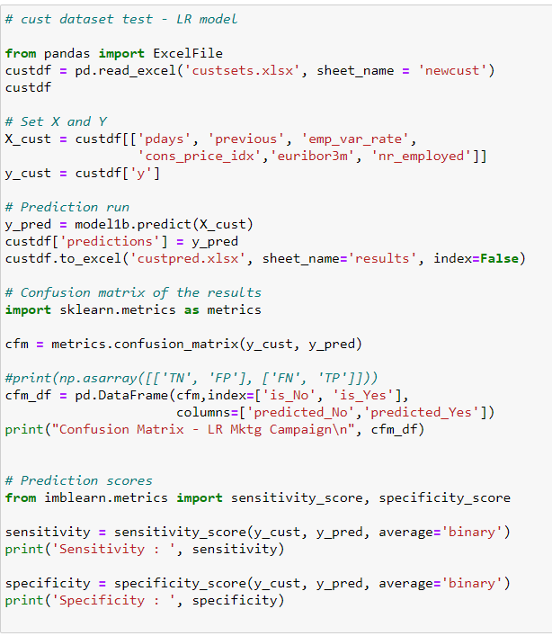
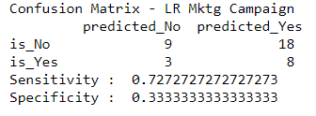
Implement
Submit an excel file containing list of 38 customers with the identified features
Smaller list of customers (26) in an excel file to call with 30% (8/26) success rate
VS
Original list of customers to call with 28% (11/38) success rate

Slide 15
Appendix

Slide 16
Details in Kaggle
Bank marketing campaigns dataset analysis # Opening a Term Deposit
It is a dataset that describing Portugal bank marketing campaigns results. Conducted campaigns were based mostly on direct phone calls, offering bank client to place a term deposit. If after all marking afforts client had agreed to place deposit - target variable marked 'yes', otherwise 'no'
Sourse of the data https://archive.ics.uci.edu/ml/datasets/bank+marketing
Citation Request:
This dataset is public available for research. The details are described in S. Moro, P. Cortez and P. Rita. A Data-Driven Approach to Predict the Success of Bank Telemarketing. Decision Support Systems, Elsevier, 62:22-31, June 2014
Title: Bank Marketing (with social/economic context)
Sources Created by: Sérgio Moro (ISCTE-IUL), Paulo Cortez (Univ. Minho) and Paulo Rita (ISCTE-IUL) @ 2014
Past Usage:
The full dataset (bank-additional-full.csv) was described and analyzed in:
S. Moro, P. Cortez and P. Rita. A Data-Driven Approach to Predict the Success of Bank Telemarketing. Decision Support Systems (2014), doi:10.1016/j.dss.2014.03.001.
https://www.kaggle.com/volodymyrgavrysh/bank-marketing-campaigns-dataset

Slide 17
Details in Kaggle
Relevant Information:
This dataset is based on "Bank Marketing" UCI dataset (please check the description at: http://archive.ics.uci.edu/ml/datasets/Bank+Marketing). The data is enriched by the addition of five new social and economic features/attributes (national wide indicators from a ~10M population country), published by the Banco de Portugal and publicly available at: https://www.bportugal.pt/estatisticasweb. This dataset is almost identical to the one used in [Moro et al., 2014] (it does not include all attributes due to privacy concerns). Using the rminer package and R tool (http://cran.r-project.org/web/packages/rminer/), we found that the addition of the five new social and economic attributes (made available here) lead to substantial improvement in the prediction of a success, even when the duration of the call is not included. Note: the file can be read in R using: d=read.table("bank-additional-full.csv",header=TRUE,sep=";")
The binary classification goal is to predict if the client will subscribe a bank term deposit (variable y).
Number of Instances: 41188 for bank-additional-full.csv
Number of Attributes: 20 + output attribute.
Attribute information:
For more information, read [Moro et al., 2014].
Input variables:
bank client data:
*1 - age (numeric)
*2 - job : type of job (categorical: "admin.","blue-collar","entrepreneur","housemaid","management","retired","self-employed","services","student","technician","unemployed","unknown")
*3 - marital : marital status (categorical: "divorced","married","single","unknown"; note: "divorced" means divorced or widowed)

Slide 18
Details in Kaggle
*4 - education (categorical: "basic.4y","basic.6y","basic.9y","high.school","illiterate","professional.course","university.degree","unknown")
5 - default: has credit in default? (categorical: "no","yes","unknown")
6 - housing: has housing loan? (categorical: "no","yes","unknown")
7 - loan: has personal loan? (categorical: "no","yes","unknown")
related with the last contact of the current campaign:
8 - contact: contact communication type (categorical: "cellular","telephone")
*9 - month: last contact month of year (categorical: "jan", "feb", "mar", …, "nov", "dec")
*10 - dayofweek: last contact day of the week (categorical: "mon","tue","wed","thu","fri")
*11 - duration: last contact duration, in seconds (numeric). Important note: this attribute highly affects the output target (e.g., if duration=0 then y="no"). Yet, the duration is not known before a call is performed. Also, after the end of the call y is obviously known. Thus, this input should only be included for benchmark purposes and should be discarded if the intention is to have a realistic predictive model.
other attributes:
*12 - campaign: number of contacts performed during this campaign and for this client (numeric, includes last contact)
*13 - pdays: number of days that passed by after the client was last contacted from a previous campaign (numeric; 999 means client was not previously contacted)
*14 - previous: number of contacts performed before this campaign and for this client (numeric)
1515 - poutcome: outcome of the previous marketing campaign (categorical: "failure","nonexistent","success")

Slide 19
Details in Kaggle
social and economic context attributes
*16 - emp.var.rate: employment variation rate - quarterly indicator (numeric)
*17 - cons.price.idx: consumer price index - monthly indicator (numeric)
*18 - cons.conf.idx: consumer confidence index - monthly indicator (numeric)
*19 - euribor3m: euribor 3 month rate - daily indicator (numeric)
20 - nr.employed: number of employees - quarterly indicator (numeric)
Output variable (desired target):
21 - y - has the client subscribed a term deposit? (binary: "yes","no")
Missing Attribute Values: There are several missing values in some categorical attributes, all coded with the "unknown" label. These missing values can be treated as a possible class label or using deletion or imputation techniques.

